Slide 1

Welcome to
Oracle Week 2024
we will start
in a few minutes

Slide 2

.NET 9 Microservices Aspnet Aspire
Shimon Dahan
November 24, 2024

Slide 3
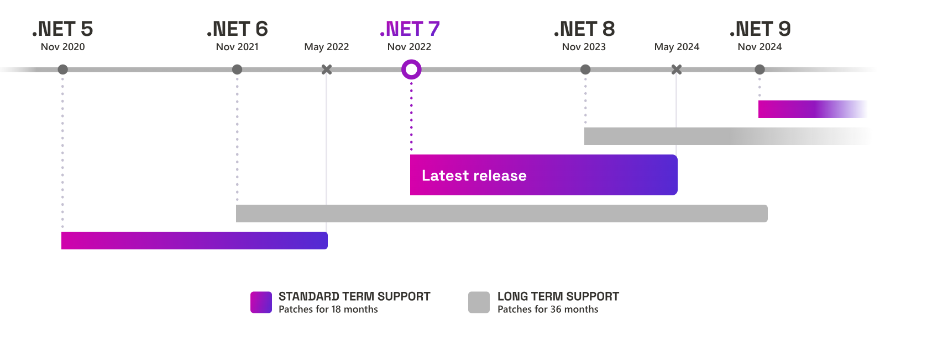

Slide 4
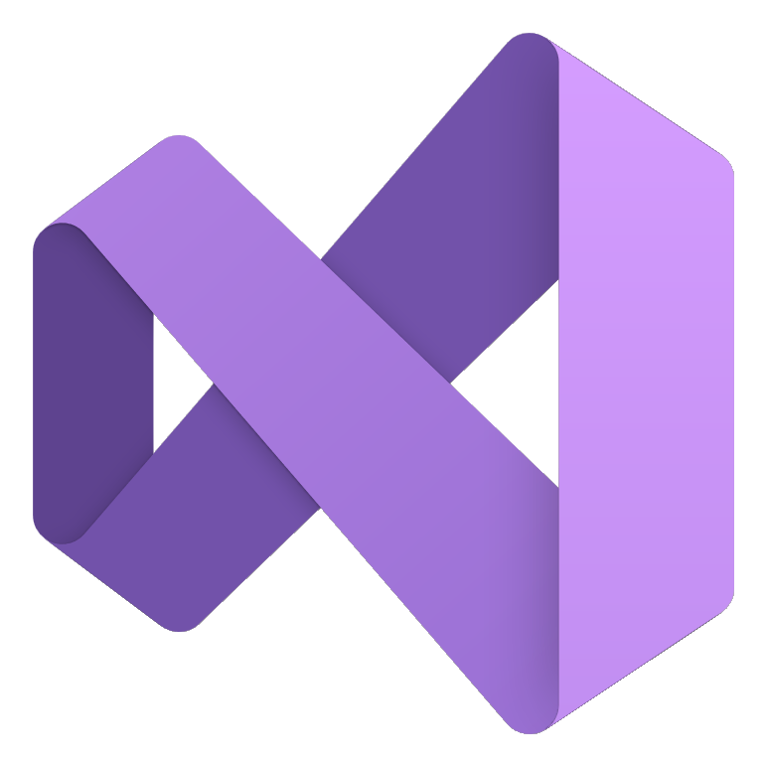










Build anything with a unified platform
.NET
Cloud
Web
Desktop
Mobile
Gaming
IoT
AI
+
+
Visual Studio
Visual Studio Code
CLI
GitHub Copilot
Windows
Linux
macOS
NuGet
GitHub
.NET Aspire
Components, tools, library vendors
Tools
Operating system
Ecosystem

Slide 5





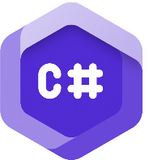





.NET Aspire
Official Launch
updates
OpenAI Library for .NET
Commitment to Security
Monthly
Unity for VS Code
Improved GitHub Copilot for .NET
C# Dev Kit
.NET MAUI for VS Code
Ubuntu 24.04
Since Last Year
Virtual Events & Live Streams
NuGet Download Increase
160
45%
Smart Components
.NET Community Toolkit + Native AOT
.NET Aspire Training
NuGet Audit 2.0
Native Library
Interop
Azure AI Inference SDK
.NET 8 Downloads
Over .NET 6
39%

Slide 6
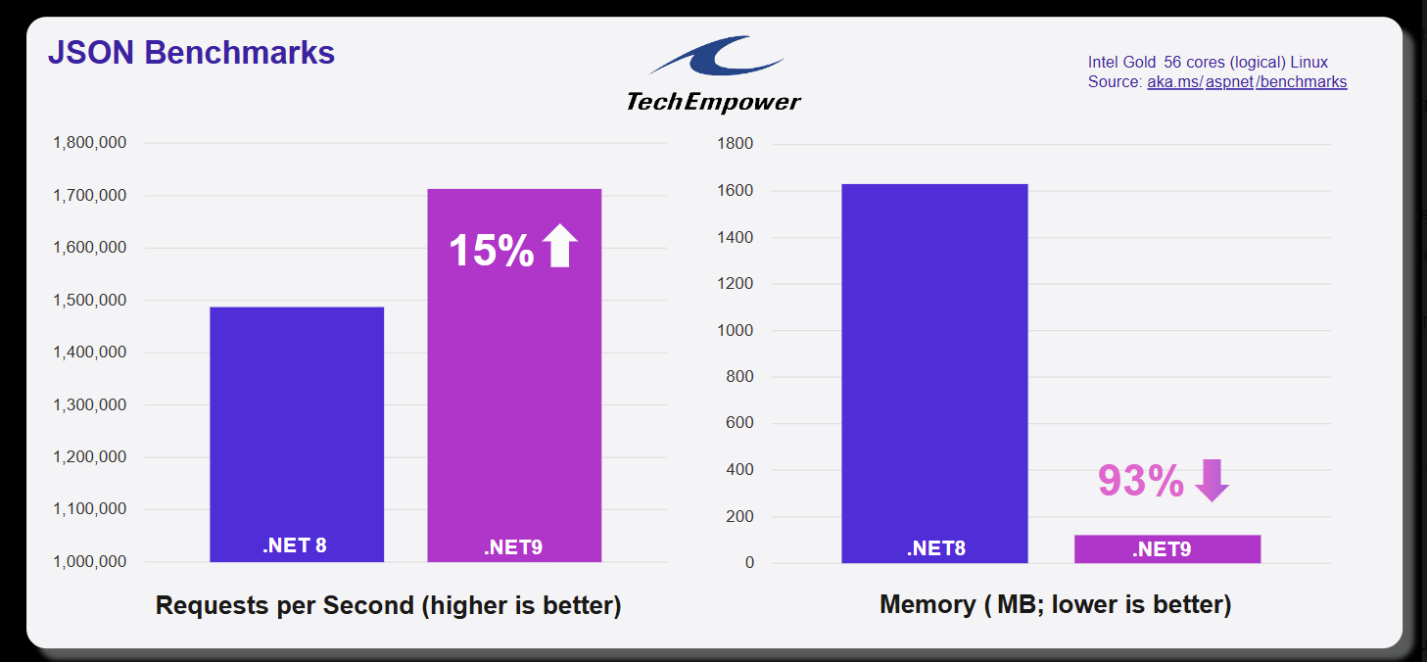

Slide 7
.NET 9 Highlights
Productive
Modern & Secure
Intelligent
Performance
.NET Aspire for improved developer inner loop
Deeper GitHub Copilot integration in Visual Studio
Hot Reload enhancements in VS Code with C# Dev Kit
Refreshed build output highlighting
Simplified Blazor authentication
Improved integration with cloud-native services & OpenTelemetry
Enhanced UI controls across Blazor, .NET MAUI, WinUI 3, WPF, and Windows Forms
dotnet restore auditing for known security vulnerabilities
.NET AI Building Blocks with Microsoft.Extensions.AI
AI Tokenizers
Tensor<T>
TensorPrimitives
.NET SDKs for vector databases
Server-Sent Event Parser
Adaptive Garbage Collection
Up to 25% faster Blazor startup
Optimized static web assets
with ref struct improvements
More Native AOT
Trimming optimizations
New NuGet restore resolver for large projects

Slide 8
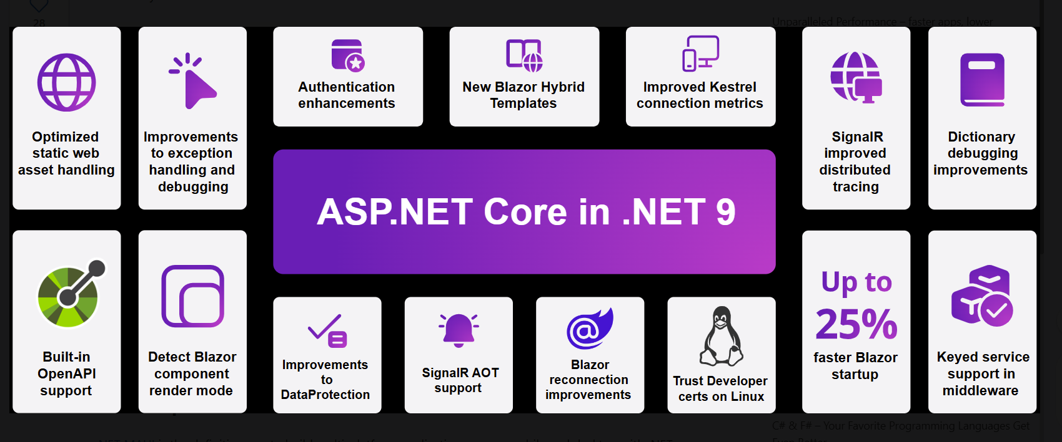

Slide 9
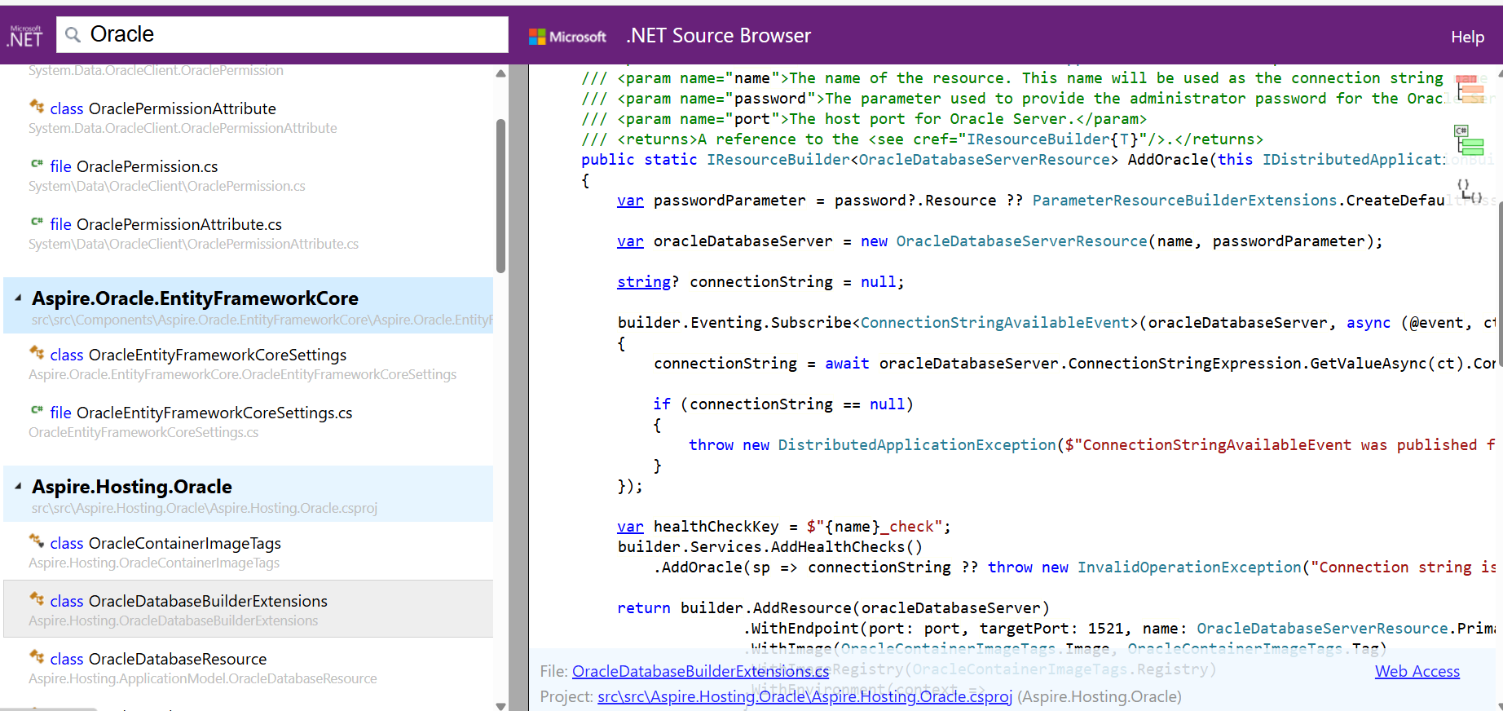
https://source.dot.net/
https://github.com/dotnet/aspnetcore
.net is open source

Slide 10

C# 9 (Released in November 2020 with .NET 5)
Init Only Setters: Allows properties to be set only during object initialization.
Records: Provides a concise syntax for defining immutable reference types.
Top-level Statements: Reduces boilerplate code for simple programs by eliminating the need for a `Main` method.
Pattern Matching Enhancements: Includes simple type patterns, relational patterns, and logical patterns.
Target-typed New Expressions: Enables you to omit the type when instantiating an object if the type is already known.

Slide 11
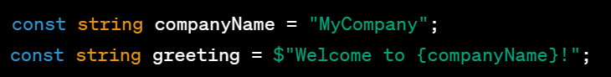
C# 10 (Released in November 2021 with .NET 6)
Global Using Directives: Allows using directives to be declared globally for the entire project.
File-scoped Namespace Declaration: Simplifies namespace declaration for files containing a single namespace.
Constant Interpolated Strings: Allows constant strings to use interpolated string syntax.

Slide 12
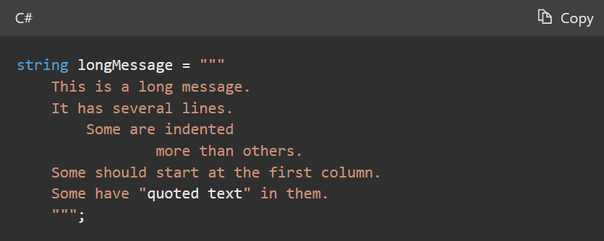
C# 11 (Expected release in November 2022 with .NET 7)
Required Members: Allows you to specify that certain properties or fields must be initialized.
Raw string literals : A raw string literal starts with at least three double-quote (""") characters

Slide 13
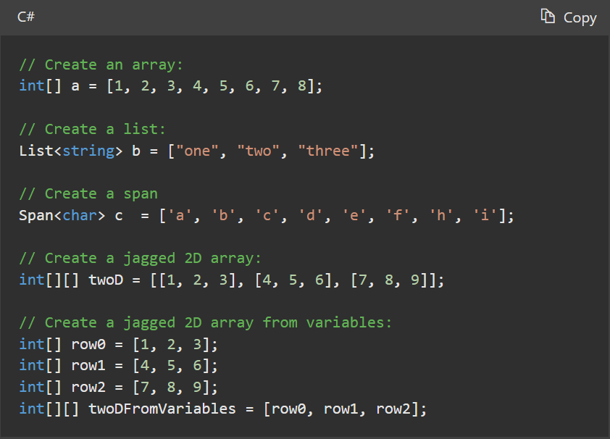
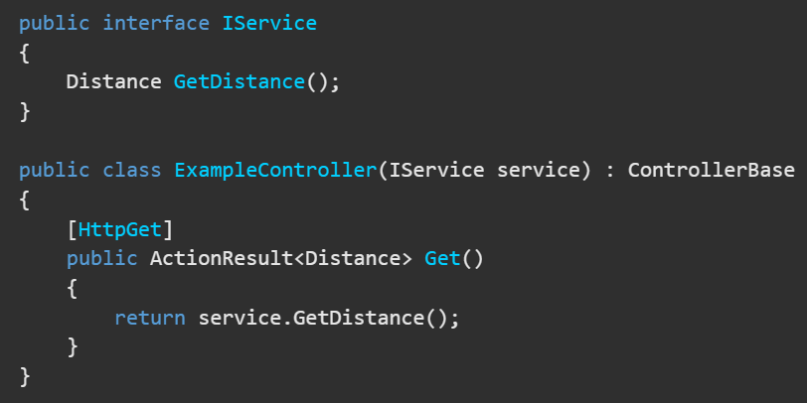
C# 12 (.NET 8)
Primary Constructors: Simplifies the syntax for defining constructors.
Collection expressions:

Slide 14
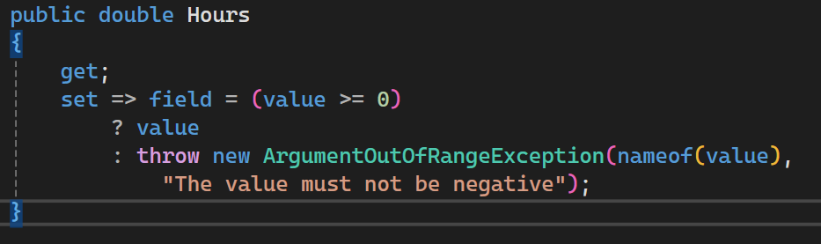
C# 13 (.NET 9)
The field keyword enables you to write an accessor body without declaring an explicit backing field in your type declaration.

Slide 15
.NET Configuration System
A brief overview of .NET Configuration Management

Slide 16

Overview of .NET Configuration System
• .NET provides a robust configuration system to manage application settings.
• Supports hierarchical and environment-specific configurations.
• Common formats include JSON, XML, and INI files.
• Built-in support for dependency injection and options pattern.

Slide 17
Configuration in .NET
• Introduced App Configuration API for streamlined access to settings.
• Supports binding configuration to strongly-typed objects.
• Utilizes `IConfiguration` and `IOptions` interfaces.

Slide 18
Key Features and Benefits
Centralized management of settings and secrets.
Automatic reload of configuration changes.
Secure storage with integration to Vault.
Environment-specific configuration for seamless deployment.

Slide 19
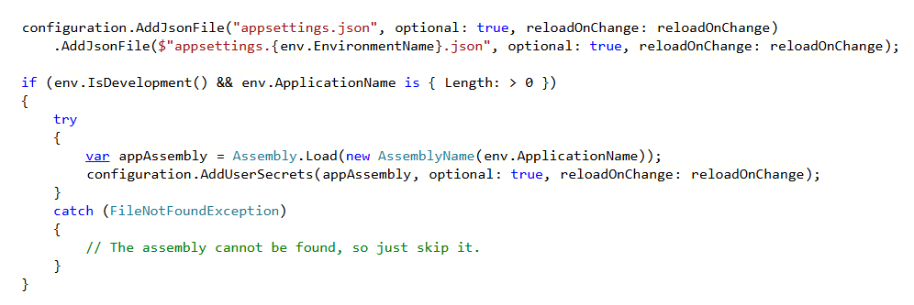
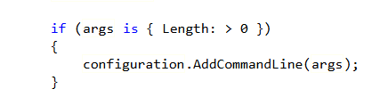
Default configuration providers
https://source.dot.net/#Microsoft.AspNetCore/WebApplicationBuilder.cs,05c8580c209de1a1,references

Slide 20

Use Minimal API instead of controllers
Simplicity and Conciseness: Minimal APIs reduce the amount of boilerplate code. You can define endpoints more succinctly, making the code easier to read and maintain.
Improved Performance: By cutting down on unnecessary layers and abstractions, minimal APIs can offer improved performance. This is particularly beneficial for microservices and high-throughput applications.
Ease of Learning: For newcomers, minimal APIs can be less daunting compared to the full MVC framework. They present a simpler way to get started with ASP.NET.
Flexibility: They allow more control over the HTTP pipeline, offering flexibility for developers to handle requests and responses directly.
Better Suitability for Microservices: Due to their lightweight nature, minimal APIs are well-suited for microservice architectures, where each service is small, and simplicity is key.
Integration with OpenAPI/Swagger: Minimal APIs support OpenAPI out of the box, making it easy to document your APIs.

Slide 21
What is Monolithic Architecture?
A monolithic application is a single unified codebase where all components are tightly integrated.
Easier to develop initially
Fewer deployment complexities
One code base

Slide 22
Resource Wastage
Inflexible Scaling
Longer Scaling Times
Risk of Performance Bottlenecks
Higher Downtime
Increased Complexity in Deployment
Infrastructure Costs
Difficulty Scaling Specific Parts

Slide 23
Risk of Downtime
All-or-Nothing Deployments:
Even if a change is made to a small part of the application (e.g., fixing a bug in the payment module), the entire monolith must be redeployed.
This increases the time required for deployment and raises the risk of introducing new issues in unrelated parts of the application.
Increased Downtime:
Deployment of a monolithic application often requires bringing down the entire system temporarily. This downtime can be unacceptable for businesses requiring high availability, especially for applications with global user bases.
Testing Complexity:
Because all modules are interconnected, any update requires extensive testing of the entire application to ensure there are no unintended side effects. This significantly delays the deployment process.
Slower Feedback Loops:
When it takes a long time to deploy changes, developers receive delayed feedback on their code. This slows down the pace of innovation and makes it harder to address issues quickly.
Risk of Breaking the System:
Updating one feature or module in a monolith can inadvertently break other parts of the system due to hidden dependencies, increasing the likelihood of bugs and outages.
Team Coordination Challenges:
In large teams working on a monolith, multiple developers or teams might be working on different parts of the application simultaneously. Changes made by one team can delay the deployment of updates by another team, causing bottlenecks.
Harder to Roll Back:
If an update introduces a critical issue, rolling back the deployment can be difficult because the entire application is updated together, making it challenging to isolate and revert specific changes.

Slide 24
Limited Technology Flexibility
Single Technology Stack Dependency:
A monolith is often built using a single language, framework, or database for all components. This limits the ability to adopt new tools or technologies that might be better suited for specific parts of the application.
Cost of Change:
Adopting new technology (e.g., transitioning to a different database for better scalability) can require refactoring the entire monolith. This process is time-consuming, expensive, and risky.
Incompatibility with Modern Tools:
Older monolithic systems may struggle to integrate with modern tools or frameworks, such as machine learning libraries, cloud-native services, or real-time analytics platforms.
Difficulty in Experimentation:
In a monolith, trying out a new technology often requires significant changes to the codebase, making it risky to experiment. This discourages teams from exploring new approaches or solutions.
Challenges in Scaling Specific Components:
Some technologies may not scale well for all parts of the application. For example, a relational database might work well for transaction management but be unsuitable for handling large-scale analytics. In a monolith, it is challenging to use different technologies for different purposes.

Slide 25
Service Discovery in .NET 9
Definition: Service discovery enables applications to locate services dynamically using logical names instead of hardcoded addresses, enhancing flexibility and scalability.
Purpose: Facilitates communication between services in distributed systems by resolving service names to their corresponding endpoints.
Key Benefits:
Simplifies service interactions.
Supports dynamic scaling and deployment.
Reduces configuration overhead.

Slide 26
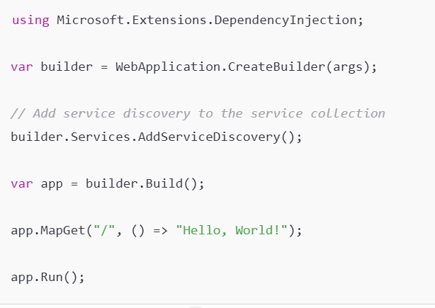
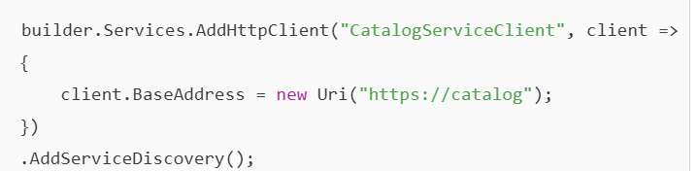
Implementing Service Discovery in .NET 9
Install the NuGet Package
dotnet add package Microsoft.Extensions.ServiceDiscovery
Configure Service Discovery
Register the service discovery services

Slide 27
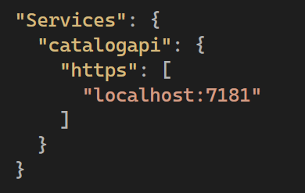
Implementing Service Discovery in .NET 9
Define Service Endpoints in Configuration:

Slide 28
Introduction to Resilience in .NET 9
What is Resilience?
The ability of an application to handle transient faults and recover gracefully without user intervention.
Importance in Modern Applications:
Ensures high availability and reliability.
Critical for distributed systems and cloud-based services.
.NET 9 Enhancements:
Built-in resilience libraries.
Simplified APIs for implementing resilience patterns.
Improved integration with HTTP clients and microservices.

Slide 29
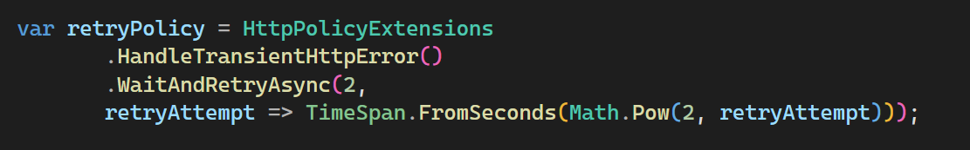
Retry Policy Automatically retries a failed operation a specified number of times before throwing an exception.

Slide 30
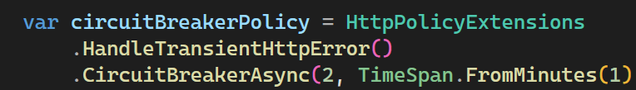
Circuit Breaker Policy
The Circuit Breaker Policy acts like an electrical circuit breaker in software applications. It prevents an application from repeatedly trying to execute an operation that's likely to fail, allowing the failing service time to recover.

Slide 31
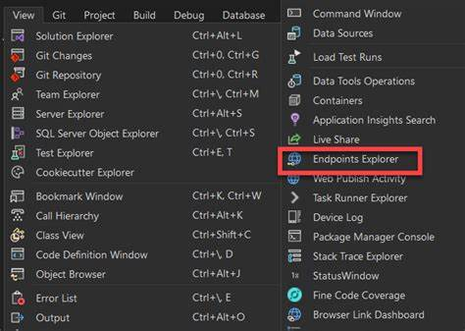
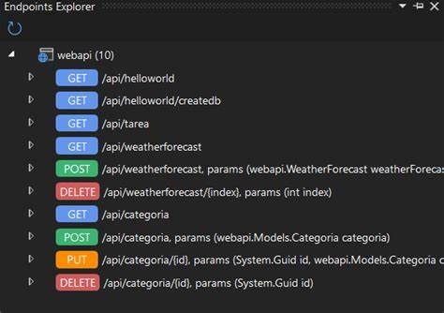
New Endpoints Explorer
The Endpoint Explorer in Visual Studio 2022 is a feature that significantly streamlines the process of working with API endpoints within your projects. It allows developers to easily discover, test, and interact with API endpoints directly from the Visual Studio environment, thereby enhancing productivity and simplifying the testing workflow.

Slide 32

Copilot

Slide 33
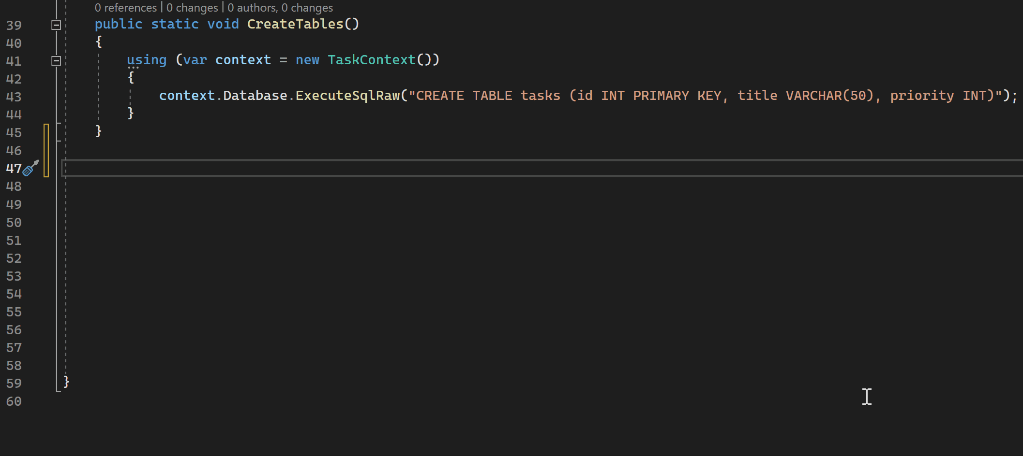

Slide 34
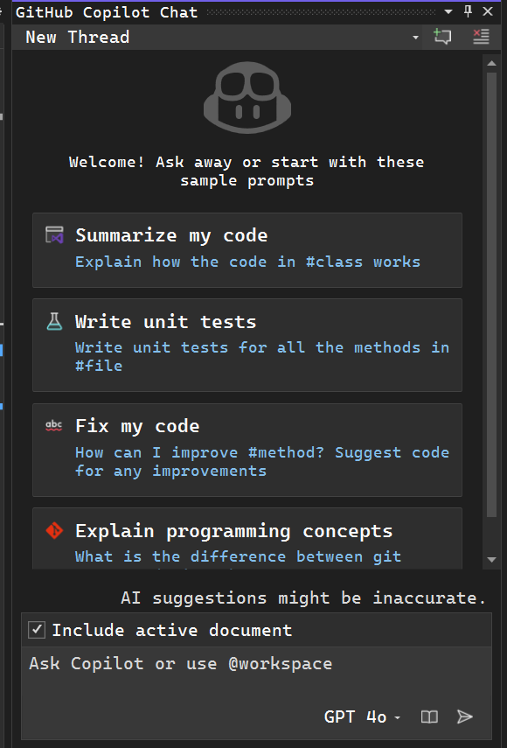
Copilot latest features
Enhanced Context Understanding: Use @workspace in Copilot Chat to reference your entire solution, enabling more comprehensive assistance.
Improved Code Completions: Refine Copilot's suggestions by adding context or asking questions without accepting them first, allowing for more tailored code completions.
AI-Powered Debugging: Copilot now offers AI-generated expressions for conditional breakpoints and tracepoints in C++, streamlining the debugging process.
Naming Suggestions: Generate naming suggestions for C++ identifiers based on usage patterns and code style, promoting consistent naming conventions.
Content Exclusion: Administrators can configure Copilot to ignore specific files or paths, ensuring sensitive information is protected during AI-assisted development.
Symbol Summaries: Hover over symbols in C# and C++ to receive AI-generated summaries, aiding in code comprehension.

Slide 35
MICROSERVICES

Slide 36
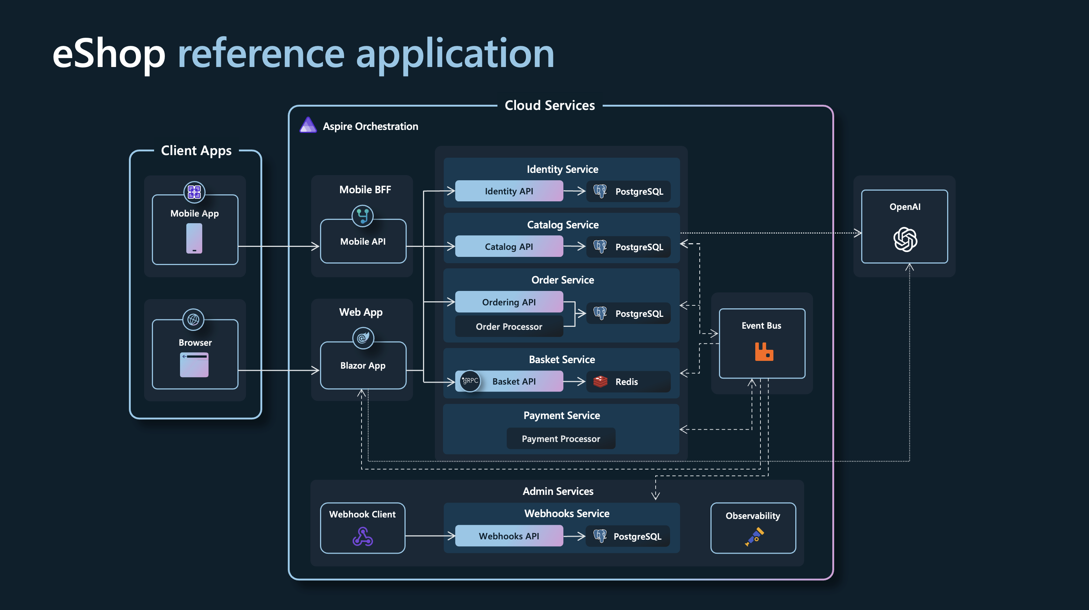

Slide 37
Microservices benefits:
Modularity: Microservices allow for breaking down the application into smaller, manageable pieces. This modularity facilitates easier understanding, development, and maintenance of each service.
Scalability: Each microservice can be scaled independently, allowing for more efficient use of resources. This is particularly advantageous in cloud environments where services can be scaled up or down based on demand.
Flexibility in Technology Stack: Different microservices can use different technologies and programming languages, allowing teams to choose the best tools for each specific task.
Resilience: Since services are independent, the failure of one service doesn't bring down the entire system. This compartmentalization enhances the overall resilience and reliability of the application.
Continuous Deployment and Delivery: Microservices enable more frequent and reliable continuous deployment and continuous integration (CI/CD) practices. Updates to individual services can be deployed without impacting the entire application.
Easier Maintenance and Debugging: Smaller codebases and service isolation make it easier to maintain and debug the application.
Improved Performance: Microservices can improve application performance, especially when they enable more efficient and distributed processing.
Better Alignment with Organizational Structure: Microservices can align well with small, cross-functional teams, where each team is responsible for specific services. This enhances both accountability and productivity.
Reduced Risk in Change Management: Changes made in one service have minimal impact on other services. This reduces the risk associated with changing code.

Slide 38
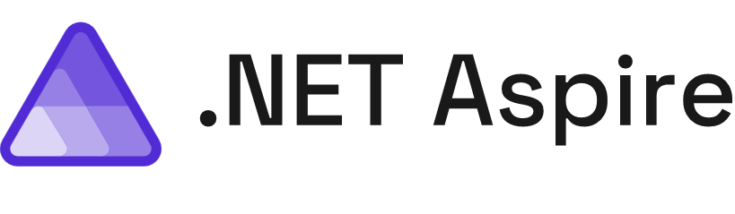
Build, test, and deploy apps seamlessly from code to cloud
Streamlined Inner-Loop
Developer Dashboard
Integrations
Deployment
Extensible, OpenTelemetry Built-in, & Ready for Any Cloud

Slide 39
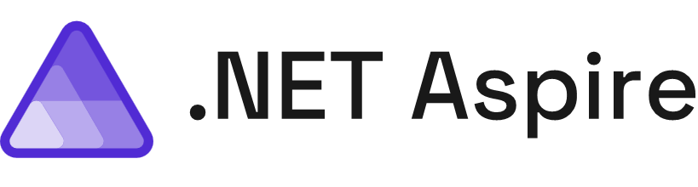
Get started
To build
Open-source
Templates
Integrations
Service discovery
Developer dashboard
Logs, metrics, distributed traces

Slide 40
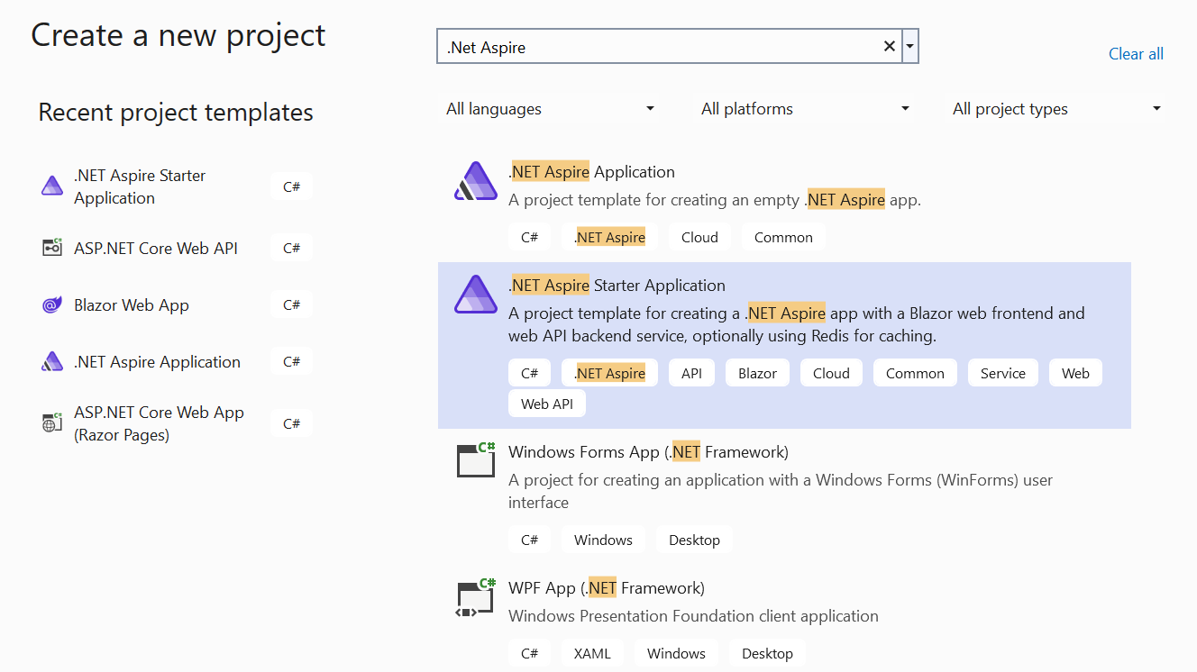

Slide 41
Default starterKit
Api Service
AppHost
ServiceDefaults
Web

Slide 42
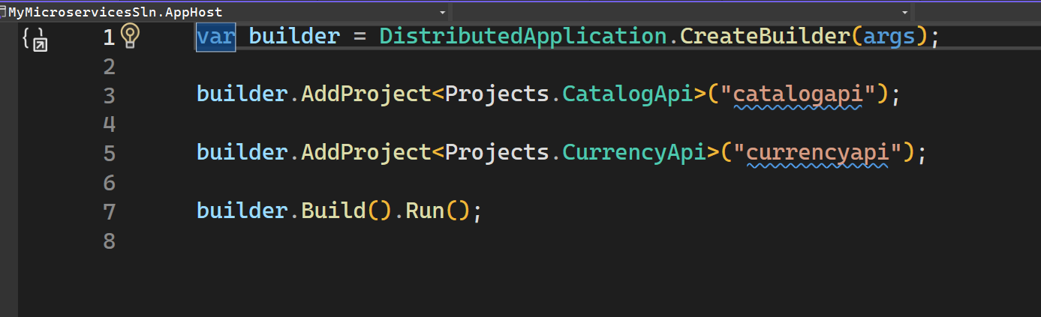
AppHost project
As the central orchestrator, AppHost coordinates the execution of all projects within the .NET Aspire app. It manages dependencies, sets up configuration settings, and ensures seamless integration between different components

Slide 43
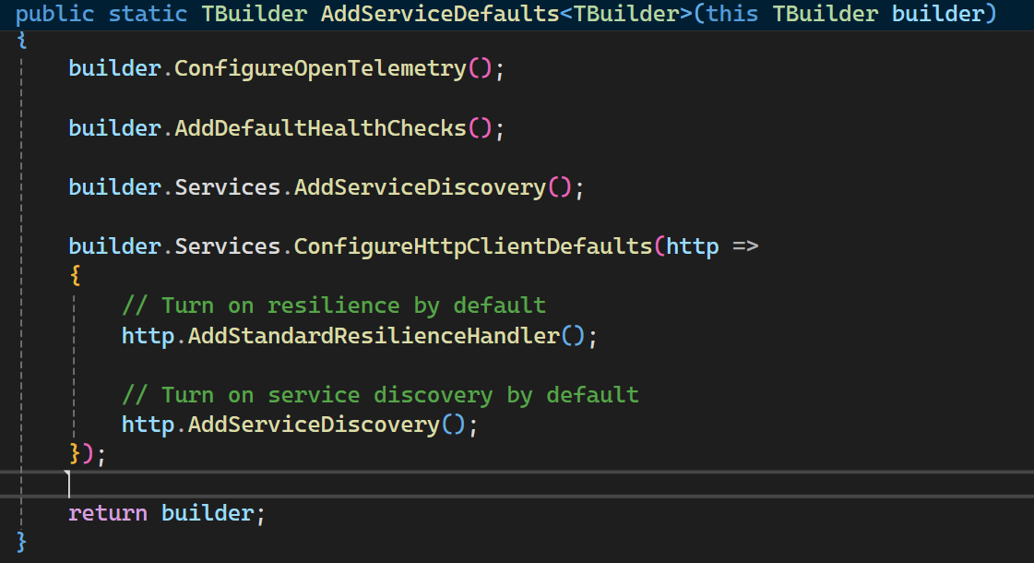
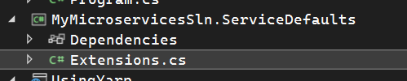
ServiceDefaults
Standardize and simplify the development process across microservices. Its primary purpose is to encapsulate common configurations, conventions, and utilities that can be reused by other services in the application ecosystem.

Slide 44
Thank You

